Slide 1

Team Name: InkWeaver Reflex
Team Members:
Abinesh B
Denistan B
Danushika N
Challenge Name:
Design and develop an LLM model that generates human-like text content which consistently evades AI detection tools while maintaining coherence, creativity, and quality.
Date: 15-11-2025

Slide 2

Problem Analysis:
AI Detector Vulnerabilities:
Limitations of Naïve Paraphrasing:
AI detection systems primarily rely on identifying statistical "fingerprints" within text. These often manifest as rigid syntactical structures, limited lexical diversity, and an unnaturally perfect adherence to grammar.
Simple paraphrasing techniques are insufficient. They often merely rearrange existing AI-generated text, failing to address the underlying stylistic patterns that detectors flag.
The Core Challenge:
Our goal is to generate coherent, creative, and relevant essays of 2000–3000 words with an AI detection rate below 20%.

Slide 3






Solution Overview:
Our solution centers on a multi-draft, self-evaluating essay generation pipeline, powered by a fine-tuned Mixtral 8x7B model. Human-likeness is not just an outcome; it's a first-class objective integrated into every stage of the process.
Plan
Develop a structured outline that interprets the prompt, selects the writer persona, and defines the narrative flow.Set strategic goals for tone, relevance, and section-wise word distribution before writing begins.
Draft
Generate the first version of each section using the selected persona and outline as guidance.Focus on producing coherent, content-rich paragraphs that form the backbone of the essay.
Critique
Evaluate every section using human-likeness metrics such as sentence diversity, discourse markers, and topical relevance.Identify weaknesses that make the text appear too synthetic, repetitive, or off-topic.
Rewrite
Refine low-scoring sections through a targeted rewrite pass that improves voice, rhythm, and relevance.Ensure each revision closely aligns with the intended tone and enhances natural readability.
Imperfections
Introduce controlled, subtle irregularities that mimic natural human writing patterns.Add mild variations in phrasing, hesitations, or connective words to avoid robotic precision.
Global Edit
Perform a final polishing pass to unify transitions, remove redundancies, and maintain narrative flow.Balance clarity and coherence while preserving the authentic human-like voice across the whole essay.

Slide 4

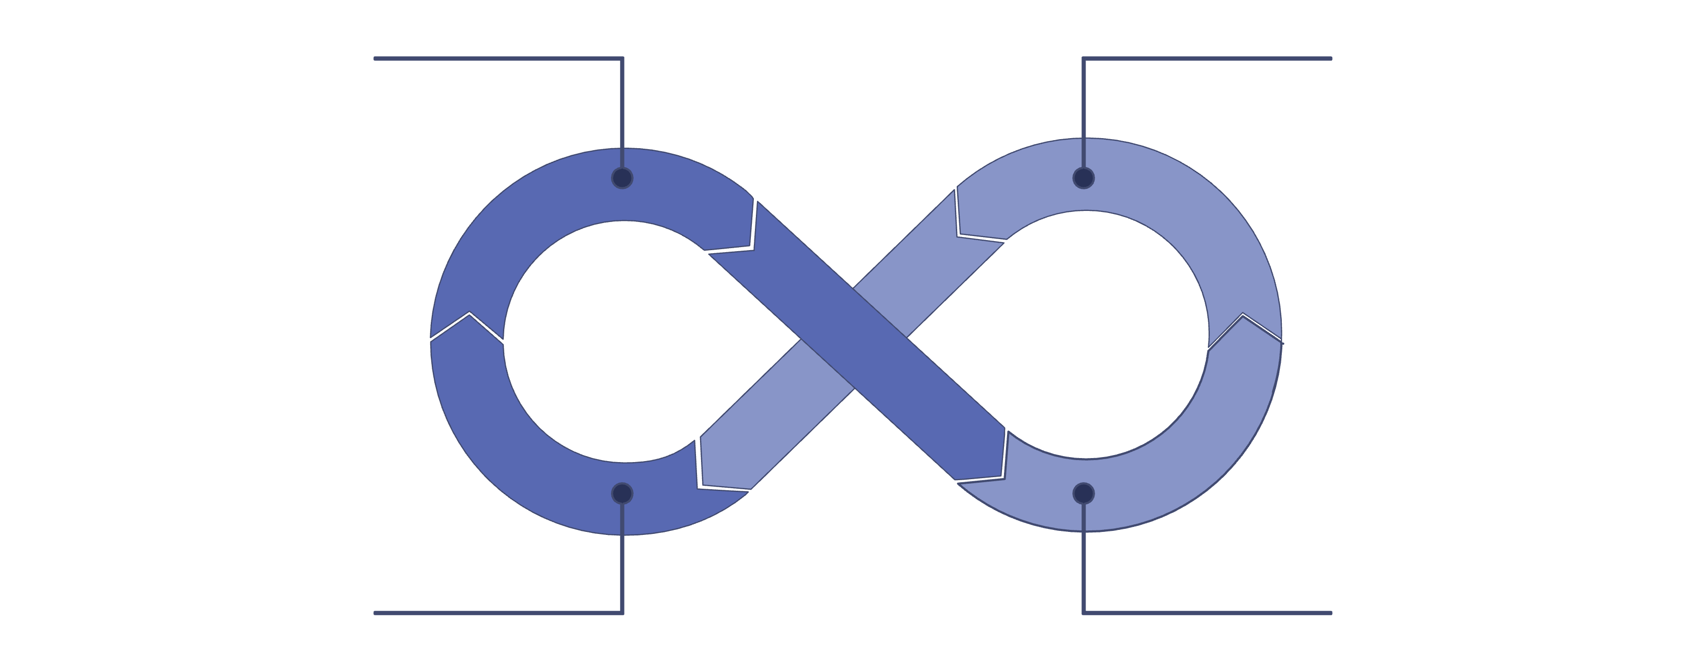
Technical Architecture:
The InkWeaver Reflex system is composed of several specialized modules working in concert to produce human-like essays. Each component plays a critical role in the iterative generation and refinement process.
Prompt → Outline
Outline → Drafts
Scoring → Final Edit
Drafts → Scoring

Slide 5

Implementation Details:
Model & Fine-tuning
Quantization & Efficiency
Config-Driven Parameters
We leverage a fine-tuned Mixtral 8x7B model, specifically trained on a diverse corpus of human-written long-form essays to internalize stylistic nuances and structural complexity.
To manage computational demands and latency, we employ quantization techniques for optimized model inference without significant performance degradation, ensuring responsive iteration.
The pipeline uses a highly configurable parameter system, allowing dynamic adjustment of essay length, persona styles, imperfection levels, and other generation variables.
_plan_essay()
_generate_sections()
Generates a comprehensive essay outline based on the initial prompt.
Drafts content for each section of the essay, following the outline.
_apply_imperfections()
edit_global()
Introduces subtle, human-like variations and minor structural "flaws".
Performs a final review and cohesive editing pass across the entire essay.

Slide 6
Key Innovations:
Human-Likeness Objective
Reflexive Rewrite Loop
Dynamic Persona Control
Unlike traditional generative models, InkWeaver Reflex explicitly prioritizes human-likeness as a primary goal throughout the entire generation and refinement process.
An iterative feedback and rewrite mechanism allows the system to continuously refine its output, learning from its "mistakes" to enhance authenticity.
The system can adopt various writing personas, enabling it to generate essays with distinct voices, styles, and rhetorical approaches, mimicking diverse human authors.
Imperfection Layer
Balanced Structure & Global Coherence
A unique module that strategically introduces subtle, non-disruptive "imperfections" such as slightly varied sentence structures, nuanced word choices, or minor deviations from overly perfect grammar, which are hallmarks of human writing.
The architecture ensures not only well-structured individual sections but also maintains overarching thematic consistency and logical flow across the entire long-form essay.

Slide 7

Results & Performance:
The InkWeaver Reflex system demonstrates promising capabilities in generating high-quality, human-like long-form essays, consistently meeting the demanding requirements of low AI detection.
2000+
<20%
High
Word Count
AI Detection
Versatility
Consistently generates essays within the target range, providing substantial content.
Preliminary evaluations show promising results, with detection rates below our critical threshold.
Successfully handles a wide range of topics, maintaining relevance and depth.
The essays exhibit structured flow and topic versatility, critical for long-form content. Crucially, the system reduces the tell-tale AI fingerprints that traditional detectors target. Our planned evaluation method will involve rigorous testing against multiple leading AI detection platforms, aiming to validate the sub-20% detection threshold across diverse outputs.

Slide 8
Challenges & Solutions:
Access Issues (Gemma-2)
Latency Management
JSON Parsing Errors
Initial model access limitations were overcome by strategic use of readily available powerful models like Mixtral 8x7B, fine-tuning them for our specific needs.
Implemented optimized inference pipelines, including quantization and batch processing, to minimize delays in the iterative generation process.
Developed robust error handling and re-prompting mechanisms to ensure consistent and valid structured output from model responses, particularly for outline generation and critique.
Over-Polished Grammar
Balancing Structure & Creativity
The "imperfection layer" was specifically designed to introduce subtle, human-like grammatical variations and stylistic quirks, breaking the overly perfect patterns of raw AI generation.
The Reflexive Orchestrator module dynamically balances adherence to the essay outline with allowing sufficient creative freedom, ensuring both cohesion and originality.

Slide 9
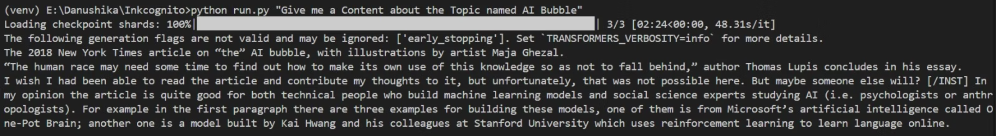

Demo Screenshots:
Witness the InkWeaver Reflex system's capabilities through various stages of essay generation. These screenshots highlights here:

Slide 10
Future Scope:
The journey for InkWeaver Reflex continues beyond its current capabilities. Our future roadmap includes several key advancements to further enhance its intelligence, versatility, and user experience.
Learned Critic Model
Multi-Detector Feedback
Expanded Personas
Developing a dedicated AI critic, fine-tuned to mimic human essay graders and stylistic editors, for even more nuanced feedback.
Integrating feedback from multiple leading AI detection systems directly into the rewrite loop for more robust evasion strategies.
Broadening the library of distinct writing personas the system can emulate, offering greater stylistic range and adaptability.
Retrieval Grounding
Intuitive Web UI
Beyond Essays
Implementing advanced retrieval-augmented generation (RAG) to ensure essays are factually accurate and grounded in real-world knowledge.
Developing a user-friendly web interface to make InkWeaver Reflex accessible and easy to control for all users.
Exploring the system's potential for generating other long-form content, such as reports, articles, and creative narratives.

